Slide 1







Microservice Interactive Learning System

Slide 2
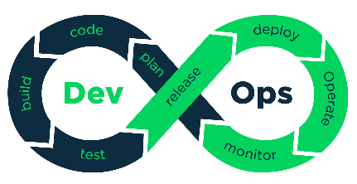
WHOA! DevOps Team
Dr : Samir Abd El-Razik
Ahmed Khalil
Rana Hesham
Ahmed Abu Zahra
Noura Abdelnaser
Heba Isamail
Mohammad Ashraf
Merna Osama
Ahmed Abu El Regal
Mohammad Anter
Eslam Khater

Slide 3












Introduction:
Problem Statement
Background
Microservices Analysis:
Conceptual Model
Backend for Frontend
Mapping work to DevOps
Team Effort
Deployment:
Docker Compose
Azure Cloud
Integration of
Components
Goals:
Team
Faculty
Students
Companies
Develop & Design:
Microservices
Architecture
Bad vs Best Practices
Design Patterns
Results
Composite UIs
Swagger API
CI/CD Badges
Simple Demo

Slide 4
01
Introduction
Business Vision
Background

Slide 5


Student

Slide 6

Skills Building
Student
The Student can be trained by Internal vs External Courses
Entertainment
Business Vision for Students
The Competitions between the students from everywhere
Interaction
The Market Share merging with the faculty service bus
Career Development
Using Acclaims and challenging techniques to create a good career

Slide 7

Adaptable
Faculty
The Faculty can adapt any type of services in just a bullet
Maintainable
Business Vision for Faculty
The Fine-Grained Microservices
Scalable
Scale Up by Upgrade HW Components
Scale Out by Using Replicas
Sustainable
Microservices is the best choice in real-world

Slide 8

First, Scaling Up The Faculty Performance

Slide 9



First, Scaling Out The Faculties Performance

Slide 10
From Mansoura University

Slide 11
To All The World

Slide 12
02
Goals
Team
Faculty
Students
Companies

Slide 13
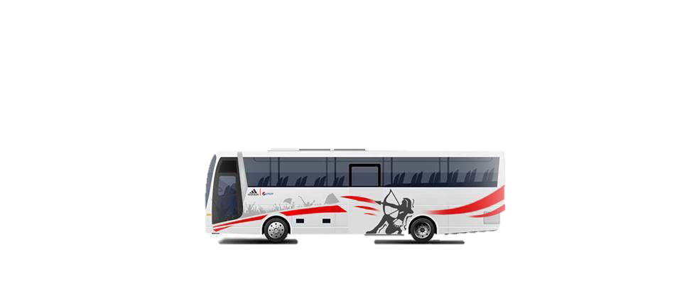
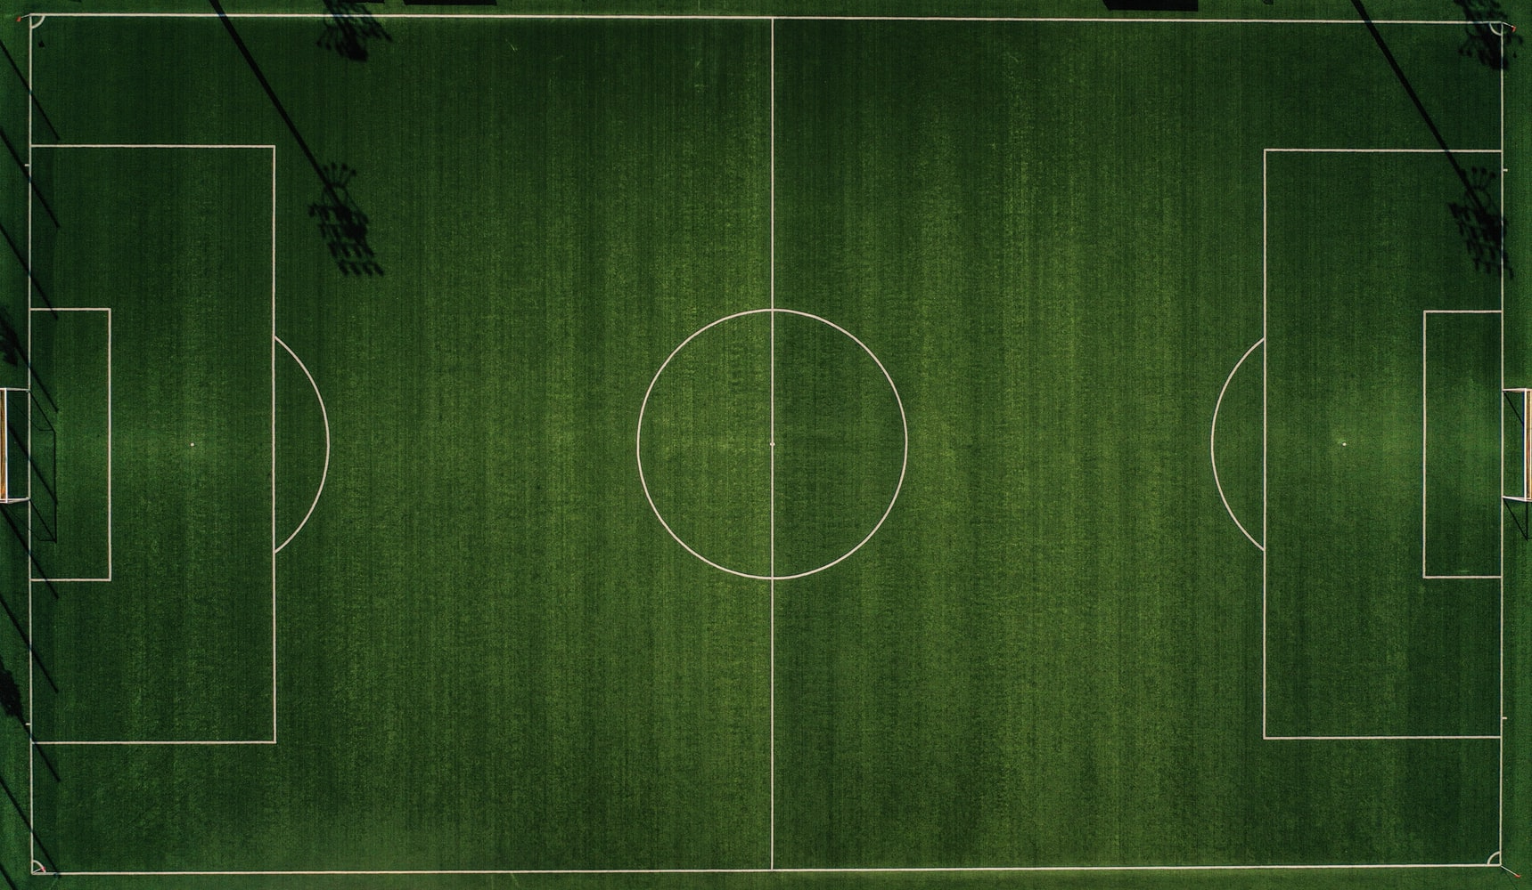
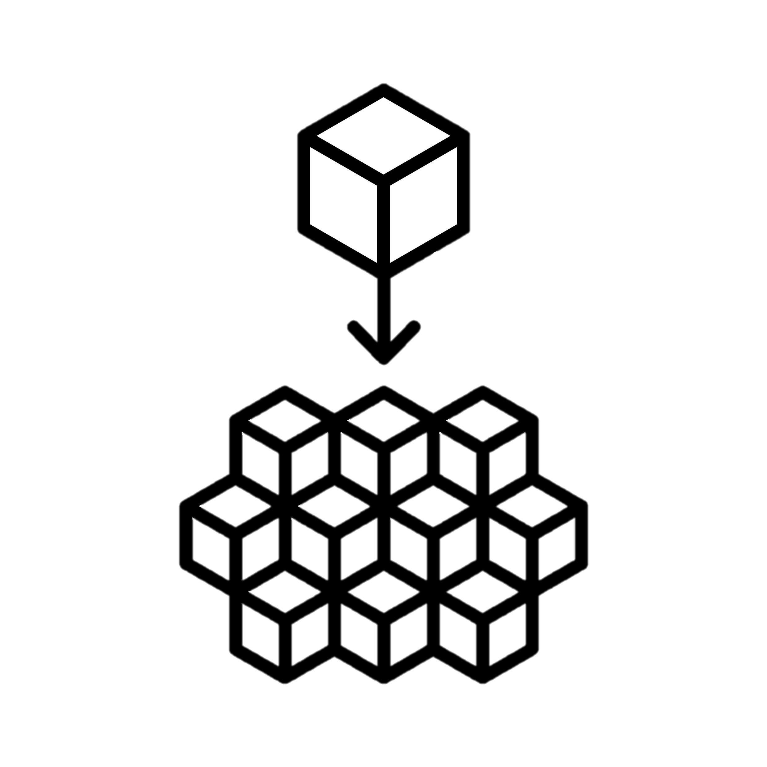
Gaining Know How Of Microservices
Getting The Zamalek’s Bus to the Super Match
VS
Team Goals

Slide 14

Teaching Techniques
Improving Teaching techniques by helping the Doctors to explore the students performance and create challenging environments
System Performance
FOR Faculty Goals
Optimizing system performance using Agile and DevOps Development methodologies
Merging External Services
Merging external services using Microservices design patterns

Slide 15





FOR Students & Companies Goals
Work Place
Learning by Practice
Easy to get a career
Inside /Outside Communication

Slide 16
03
Microservices
Analysis
Conceptual Model
Backend for Frontend
Mapping work to DevOps
Team Effort

Slide 17
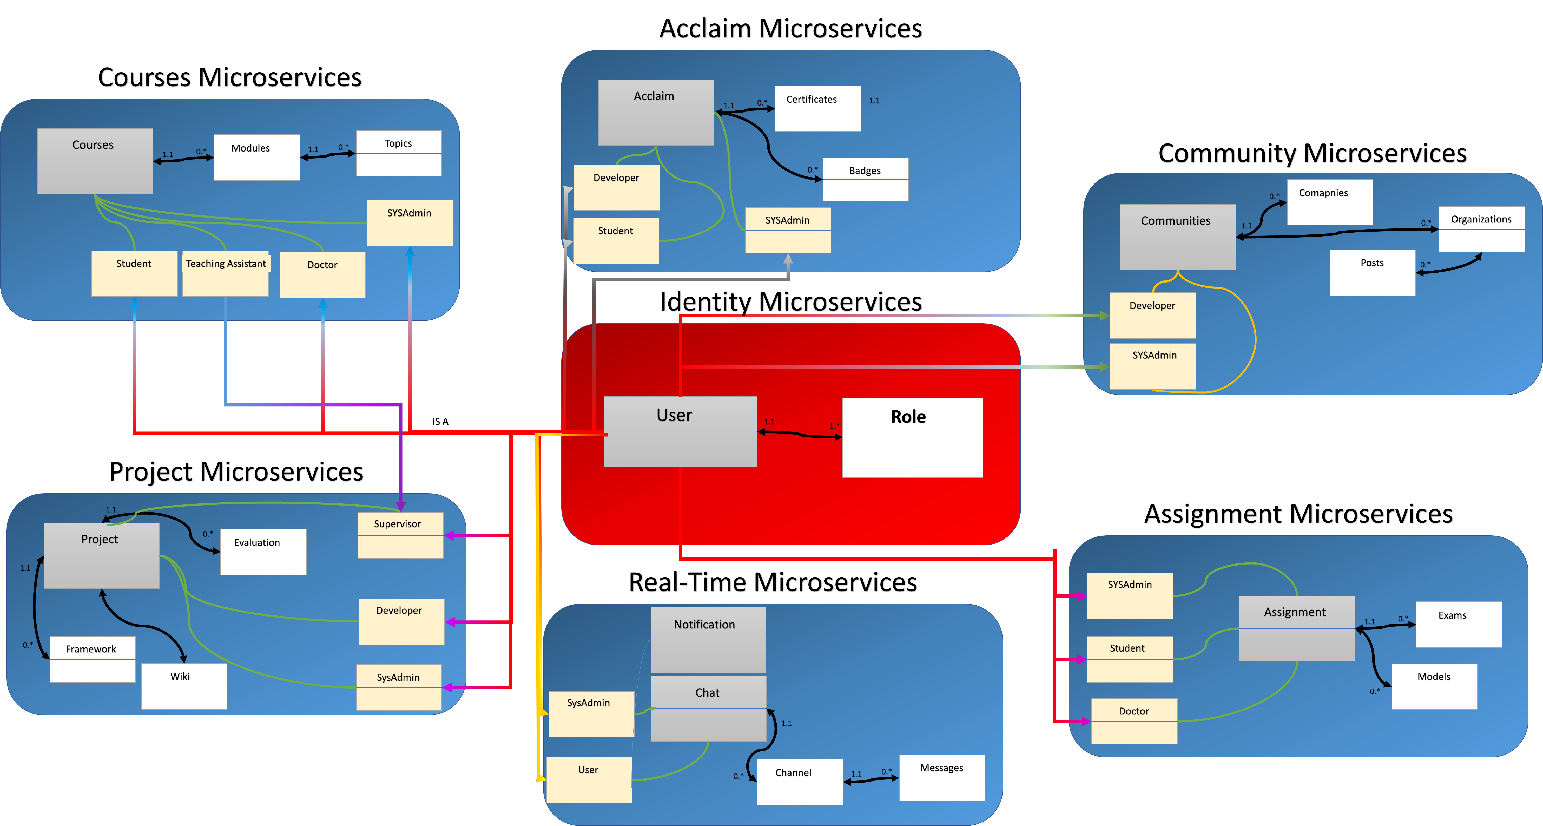
Conceptual Model
Acclaims Microservices
Courses Microservices
Communities Microservices
Identity Microservices
Projects Microservices
Assignments Microservices
Real-Time Microservices

Slide 18
Seems You know about agile
Where are the UMLs ??
Users Involvement
BFF
Microservices
Backend for frontend
A Backend for Frontend (BFF) architecture can be used to create backends for client-facing mobile or web apps.

Slide 19

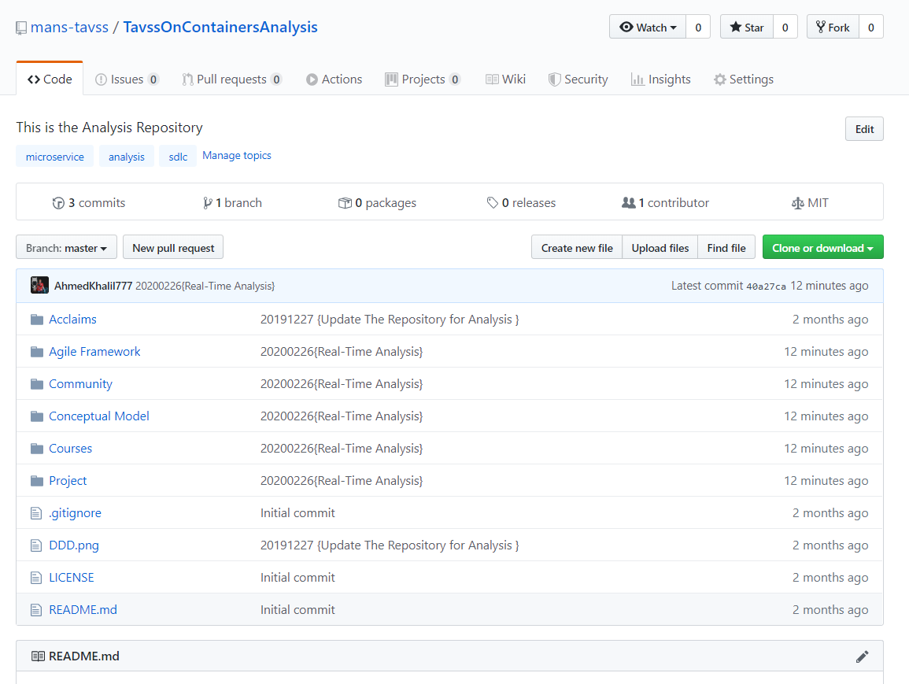
https://github.com/mans-tavss/TavssOnContainersAnalysis
All Analysis UMLs and User Stories

Slide 20
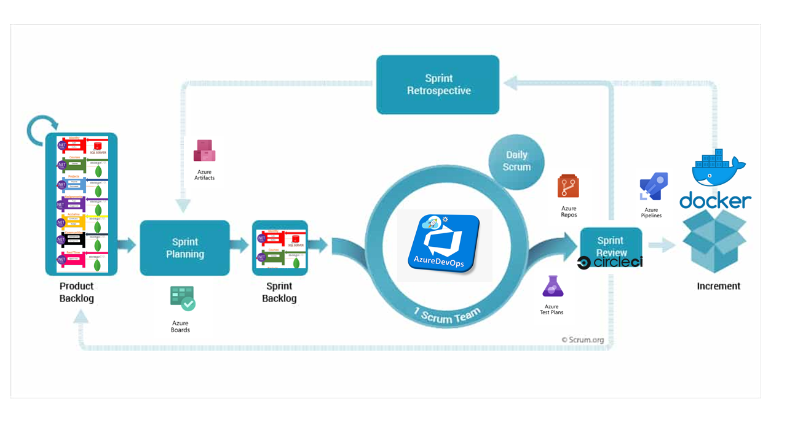
DevOps/ Scrum Framework

Slide 21
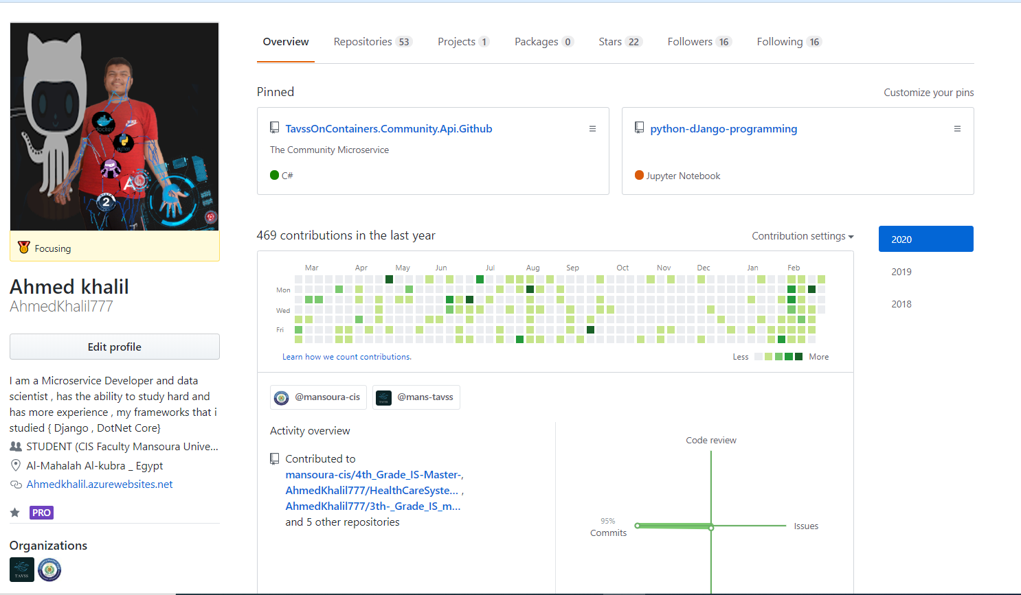
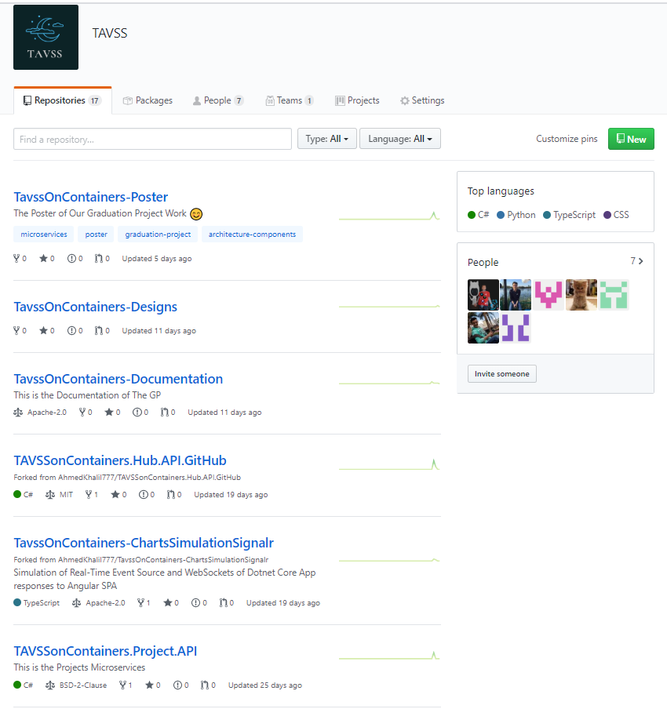
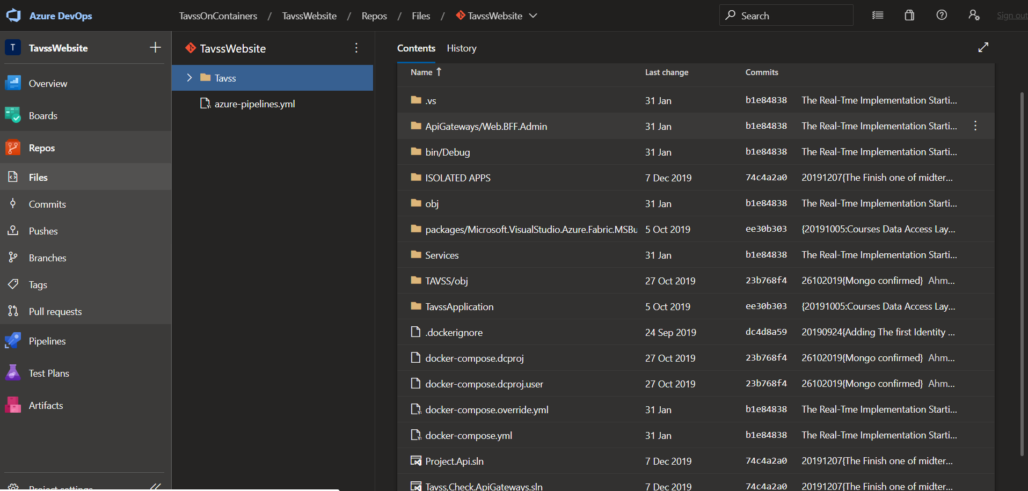

Slide 22
04
Microservices
Design & Develop
Microservices
Architecture
Bad vs Best Practices
Design Patterns

Slide 23



“If you are working in an organization that places lots of restrictions on how developers can do their work, then microservices may not be for you.”
—Sam Newman

Slide 24



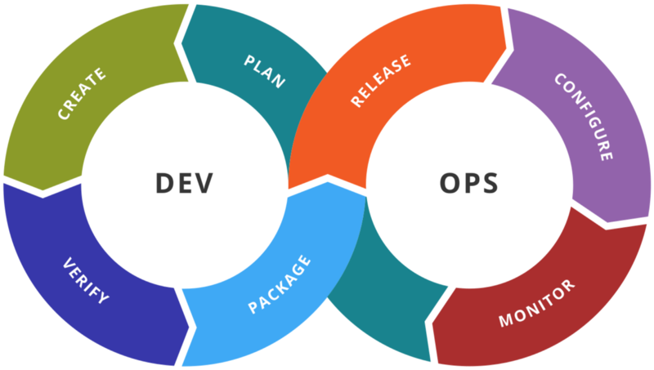

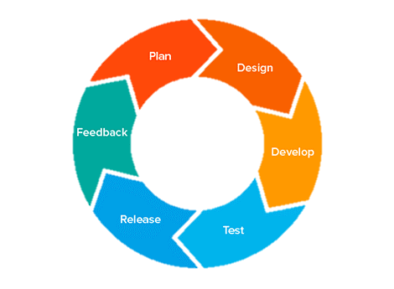
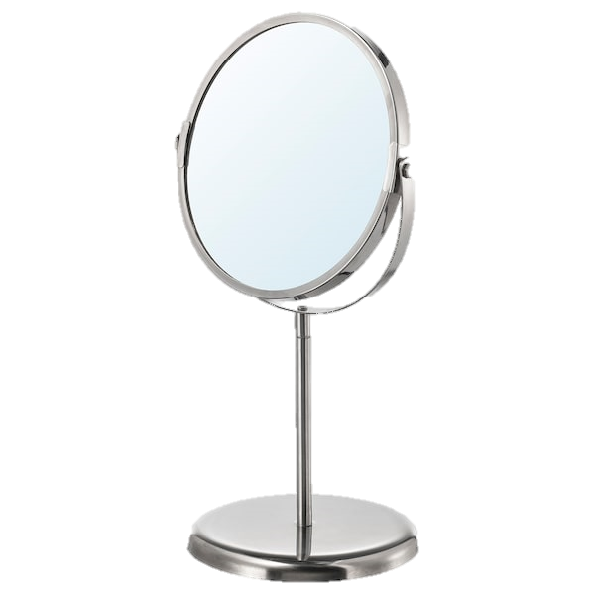
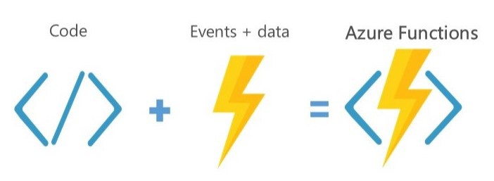
Microservices are a software development technique —a variant of the service-oriented architecture (SOA) structural style
Highly Maintainable and Testable
Lends On CI/CD Development Process
Loosely Coupled
DevOps
Independently deployable
Agile + 37%
Fine-Grained Services
Serverless Computing

Slide 25
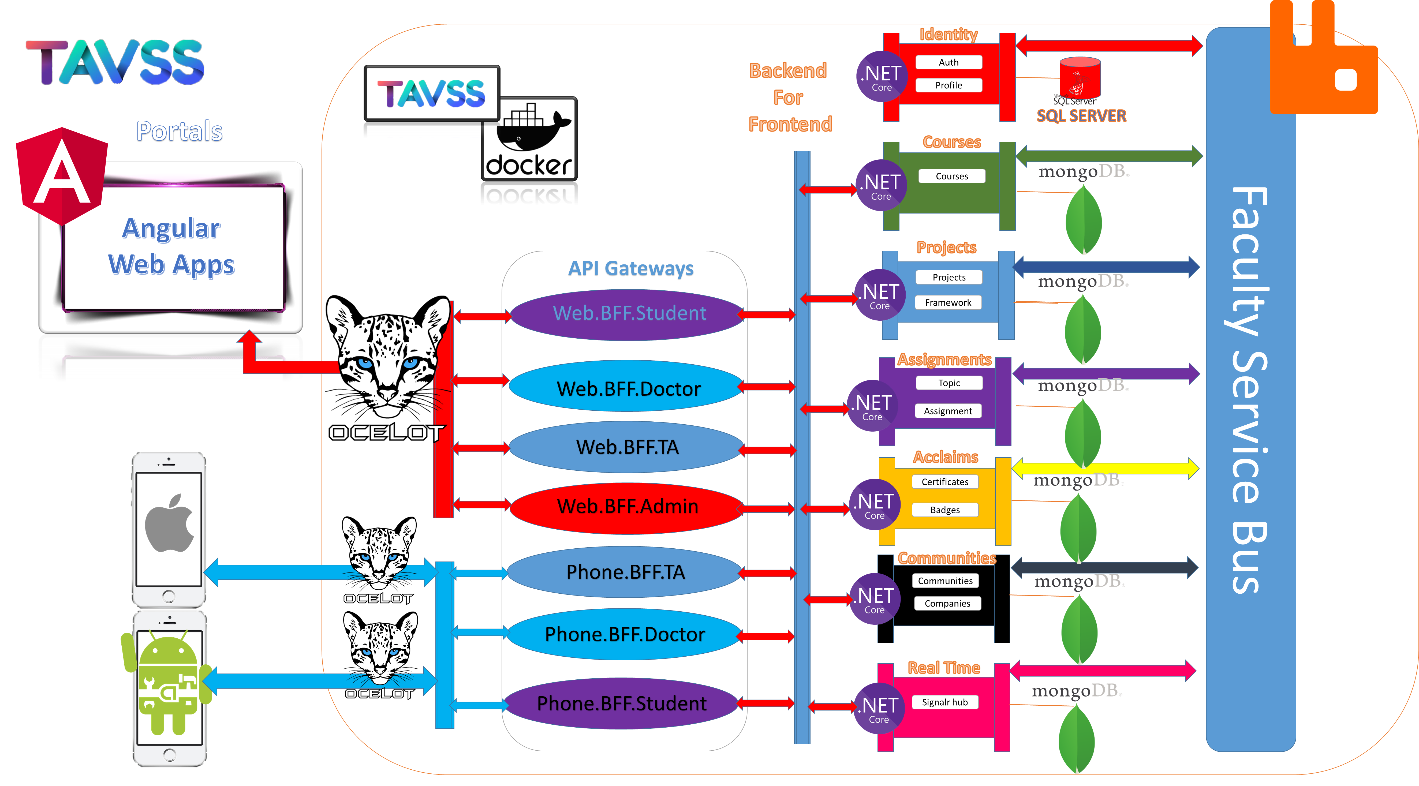

Slide 26
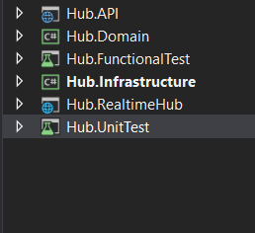

Implementing Domain Driven Design over CQRS ON Real-Time Microservices
Host
UI
API Event Source
Real-Time Hub
Web Socket
Aggregation Layer
Application Layer
Controller
Command Handler
Domain Model
Layer
Persistence Layer
Infrastructure Layer

Slide 27
05
Microservices
Deployment
Docker Compose
Azure Cloud
Integration of Components

Slide 28
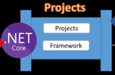


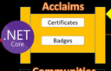
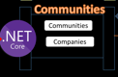
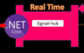
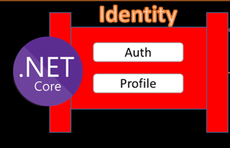
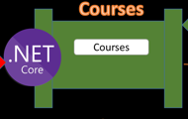
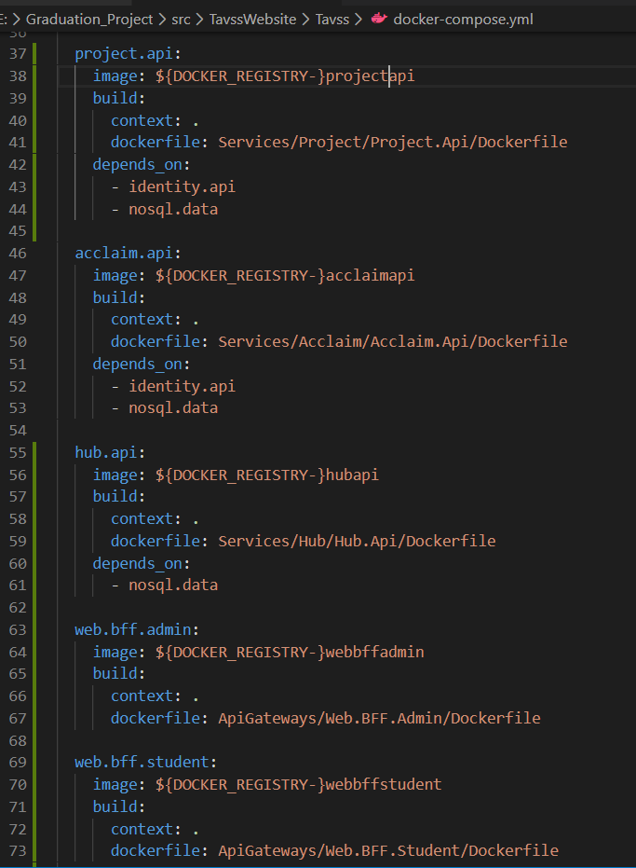
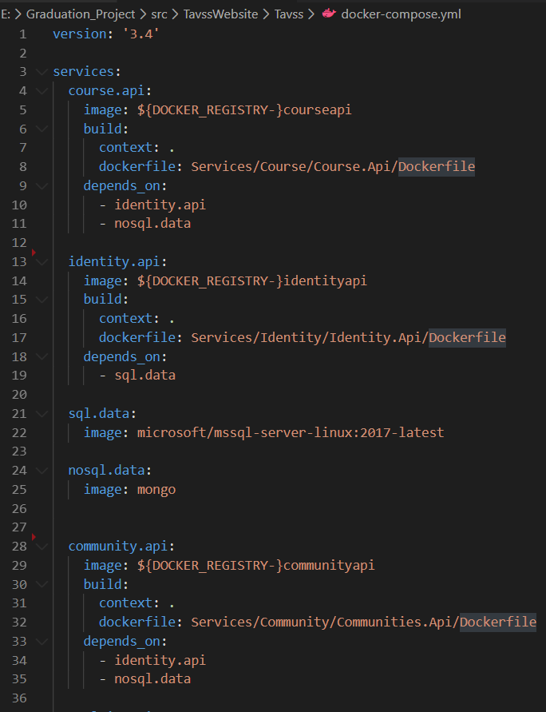
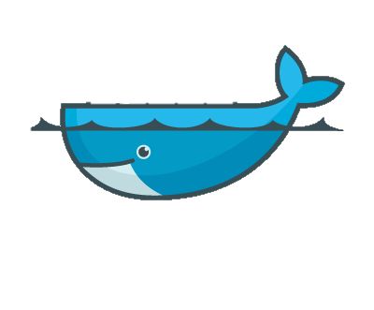
Docker Compose

Slide 29
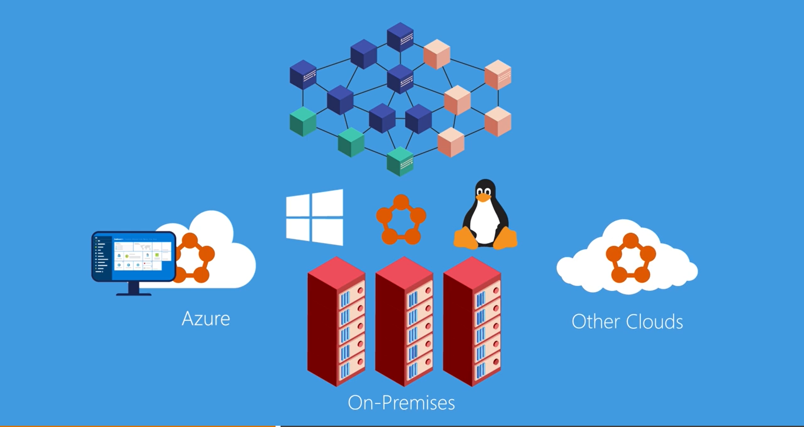
Azure Service Fabric
Notes:
Trust a proven platform for mission-critical applications
Focus on building applications and business logic, and let Azure solve the hard distributed systems problems such as reliability, scalability, management, and latency. Service Fabric is an open source project and it powers core Azure infrastructure as well as other Microsoft services such as Skype for Business, Intune, Azure Event Hubs, Azure Data Factory, Azure Cosmos DB, Azure SQL Database, Dynamics 365, and Cortana. Designed to deliver highly available and durable services at cloud-scale, Azure Service Fabric intrinsically understands the available infrastructure and resource needs of applications, enabling automatic scale, rolling upgrades, and self-healing from faults when they occur.
Choose from a variety of productive programming models and languages including .NET Core 2.0, C#, and Java to build your microservice and container-based applications. Deploy Service Fabric cluster in Azure or use Azure Service Fabric mesh - a fully managed microservices platform, currently in preview. Azure Service Fabric is also available as a free download for Windows Server, enabling you to create Service Fabric clusters on premises or in other clouds.

Slide 30
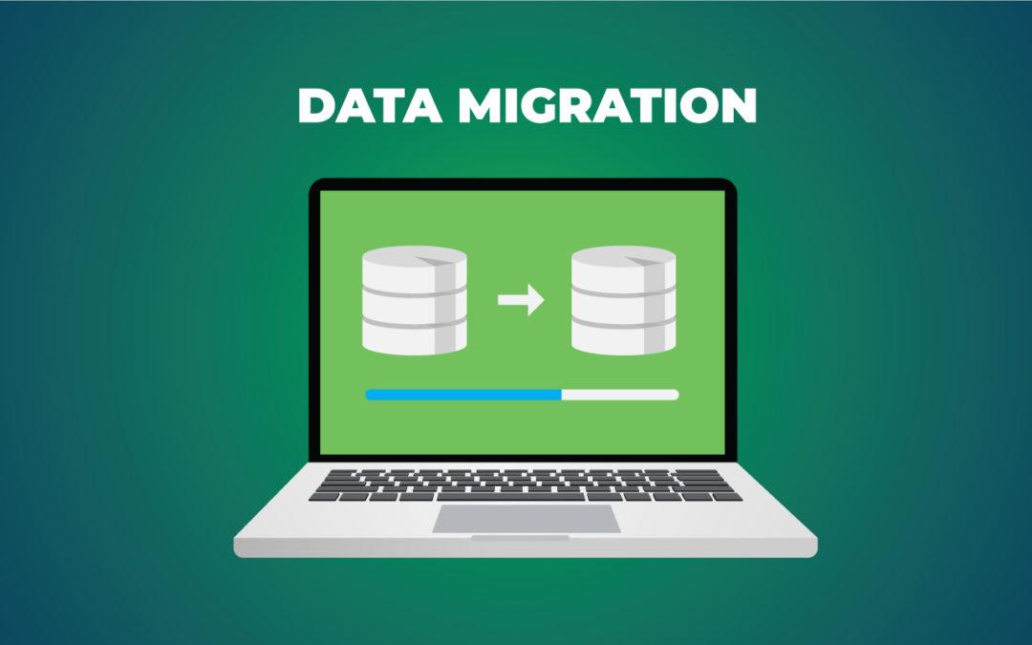
Data Seeding

Slide 31
06
Results
Composite UIs
Swagger API
CI/CD Badges
Simple Demo

Slide 32
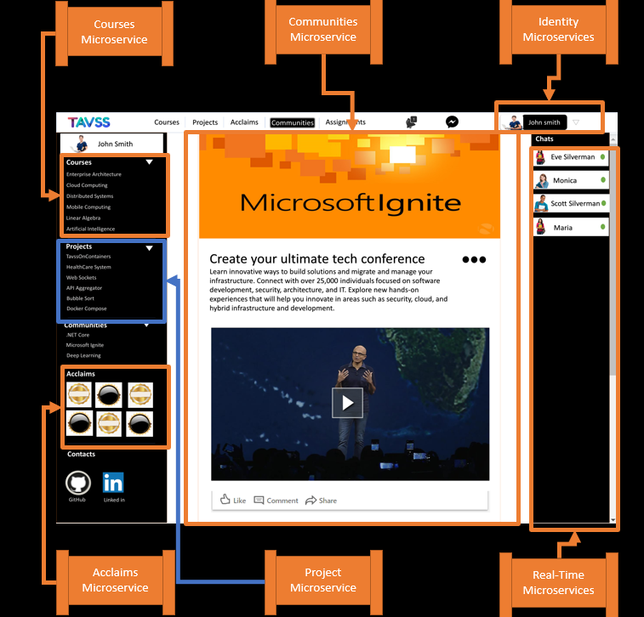

SPA Consume Microservices

Slide 33
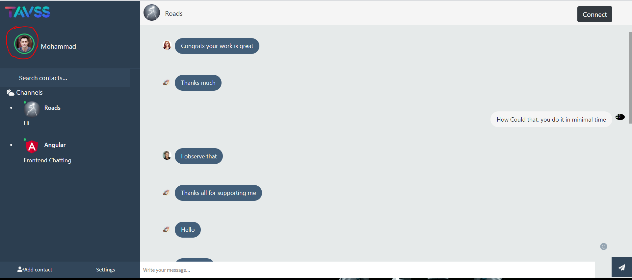

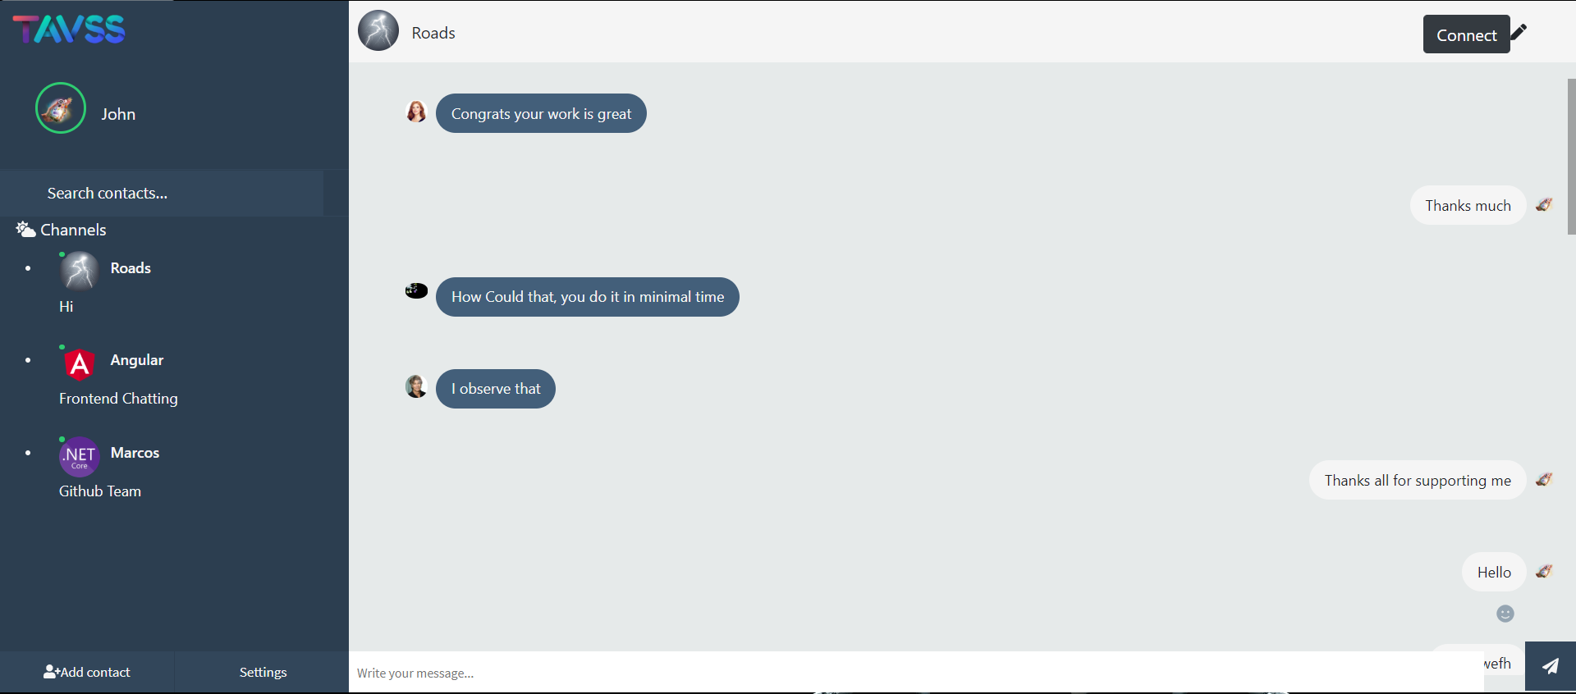
Real-Time Chatting groups

Slide 34
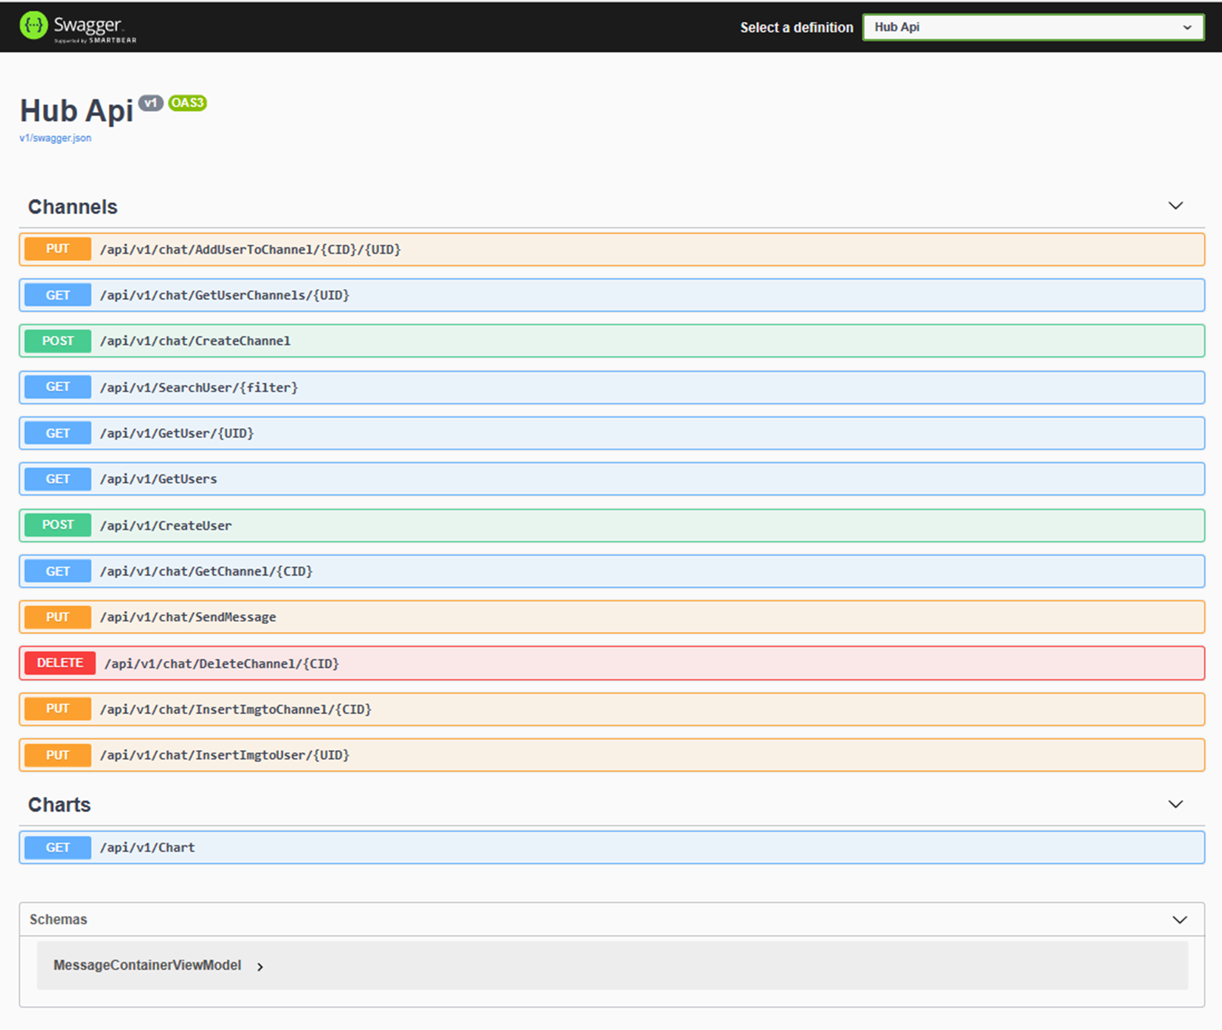

Documenting REST APIs

Slide 35
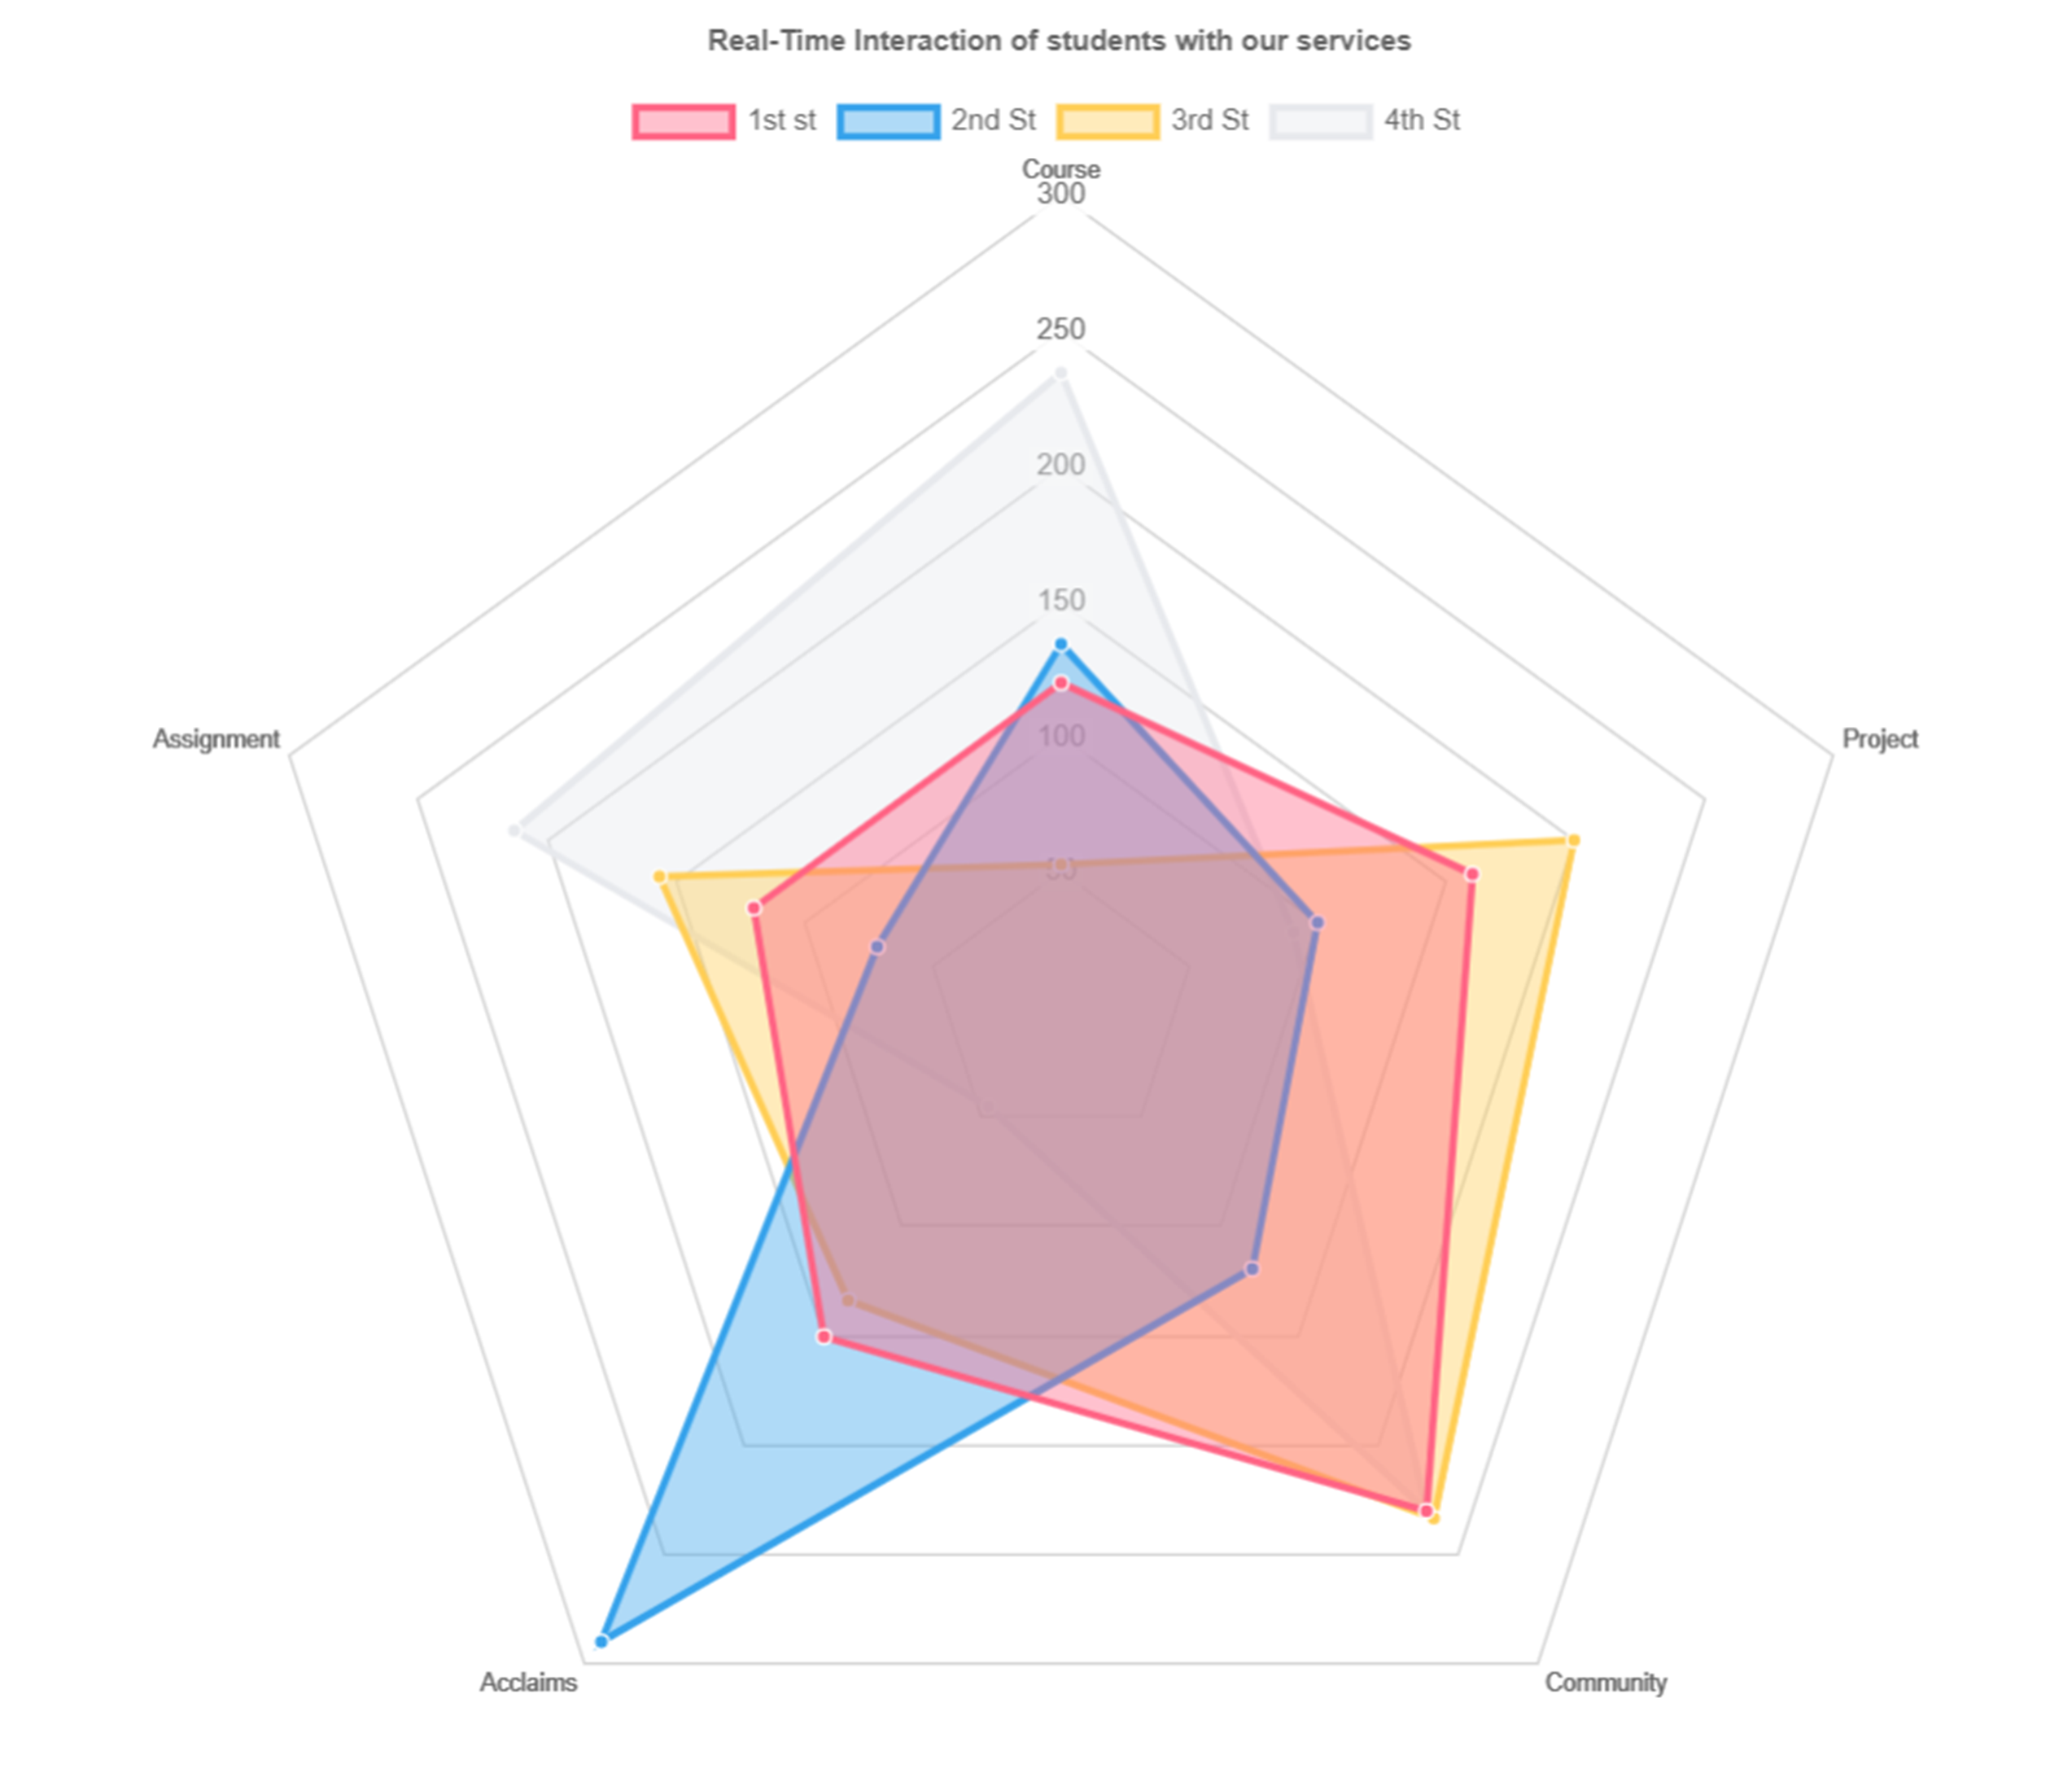

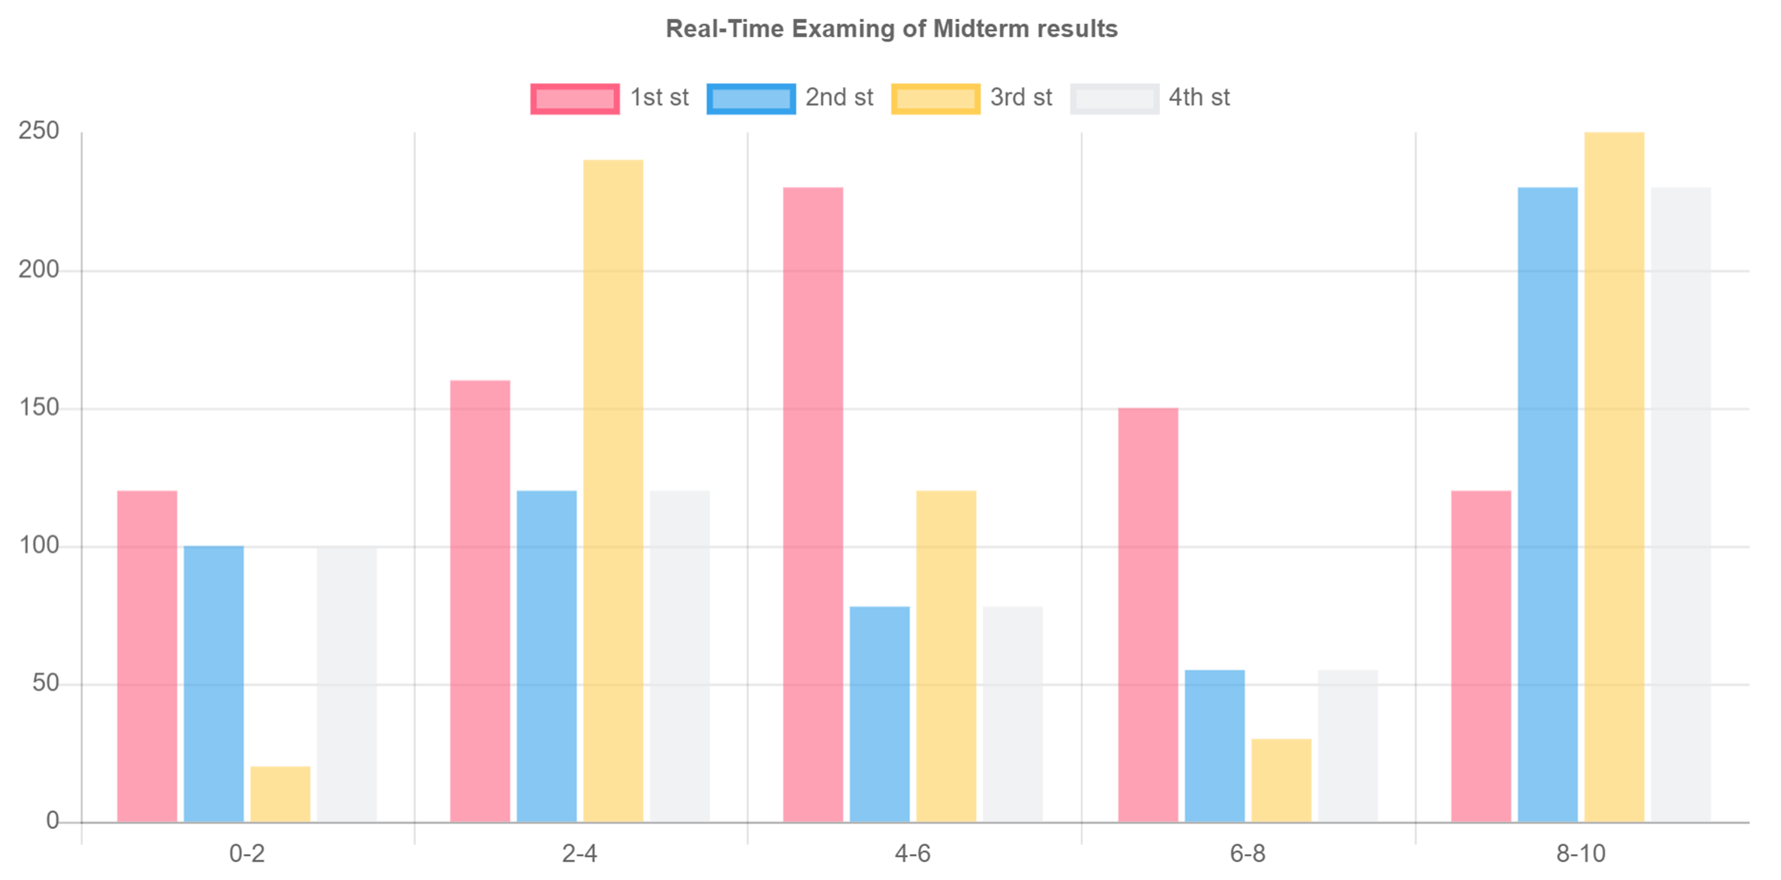
Presenting Real-Time
Monitoring Charts

Slide 36
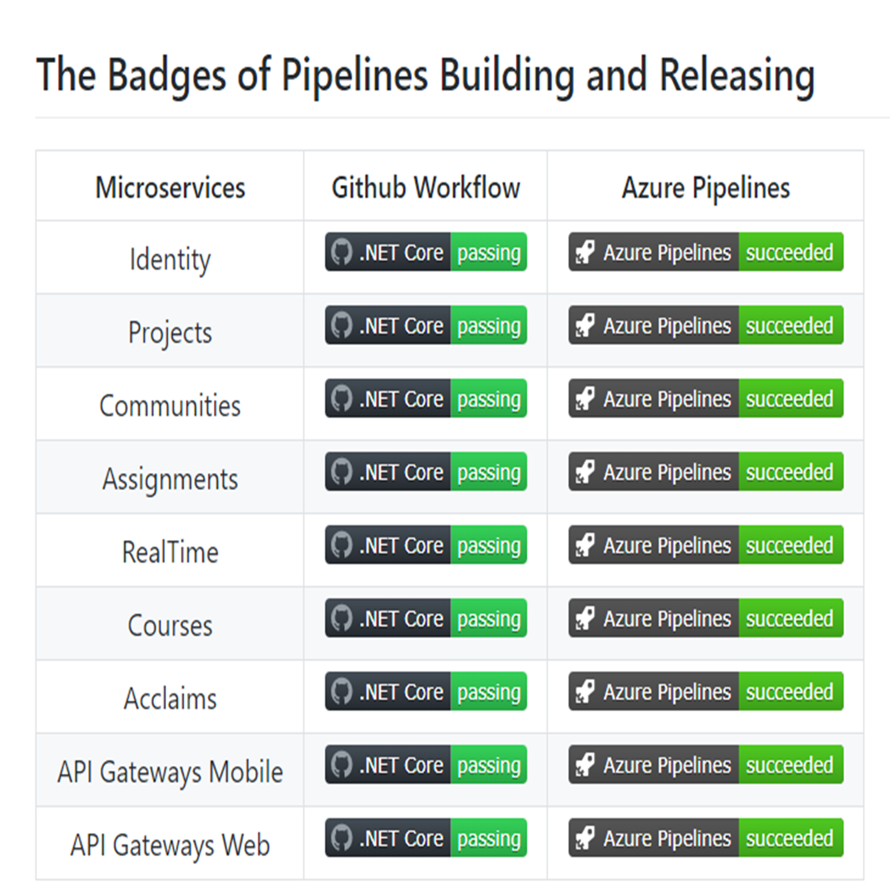
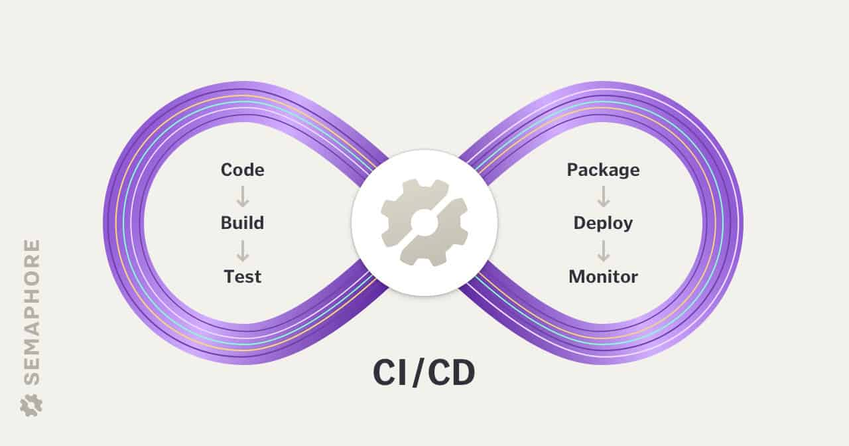
CI/CD Badges on
github and Azure

Slide 37
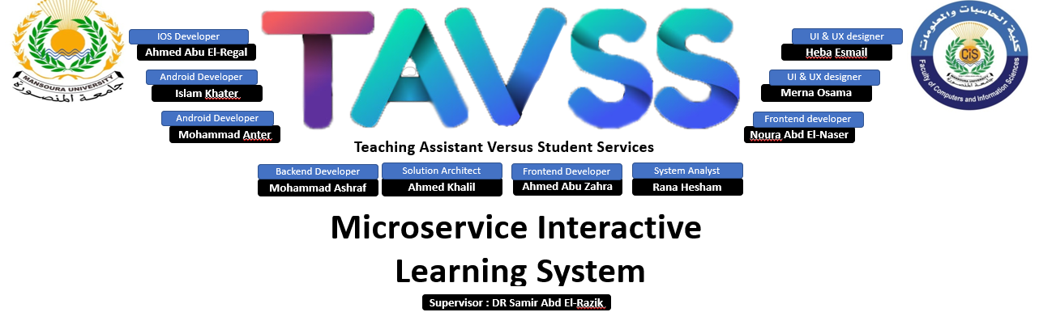
Thanks !

